Slide 1
UrbanEye
Smart Surveillance for Cleaner Cityscapes
HUSSAIN ALSHABAAN, ABDULLAH M AL-AWLAQI, RAYAN ALSUBHI
ICS504 – Deep Learning
Dr. Muzammil Behzad

Slide 2
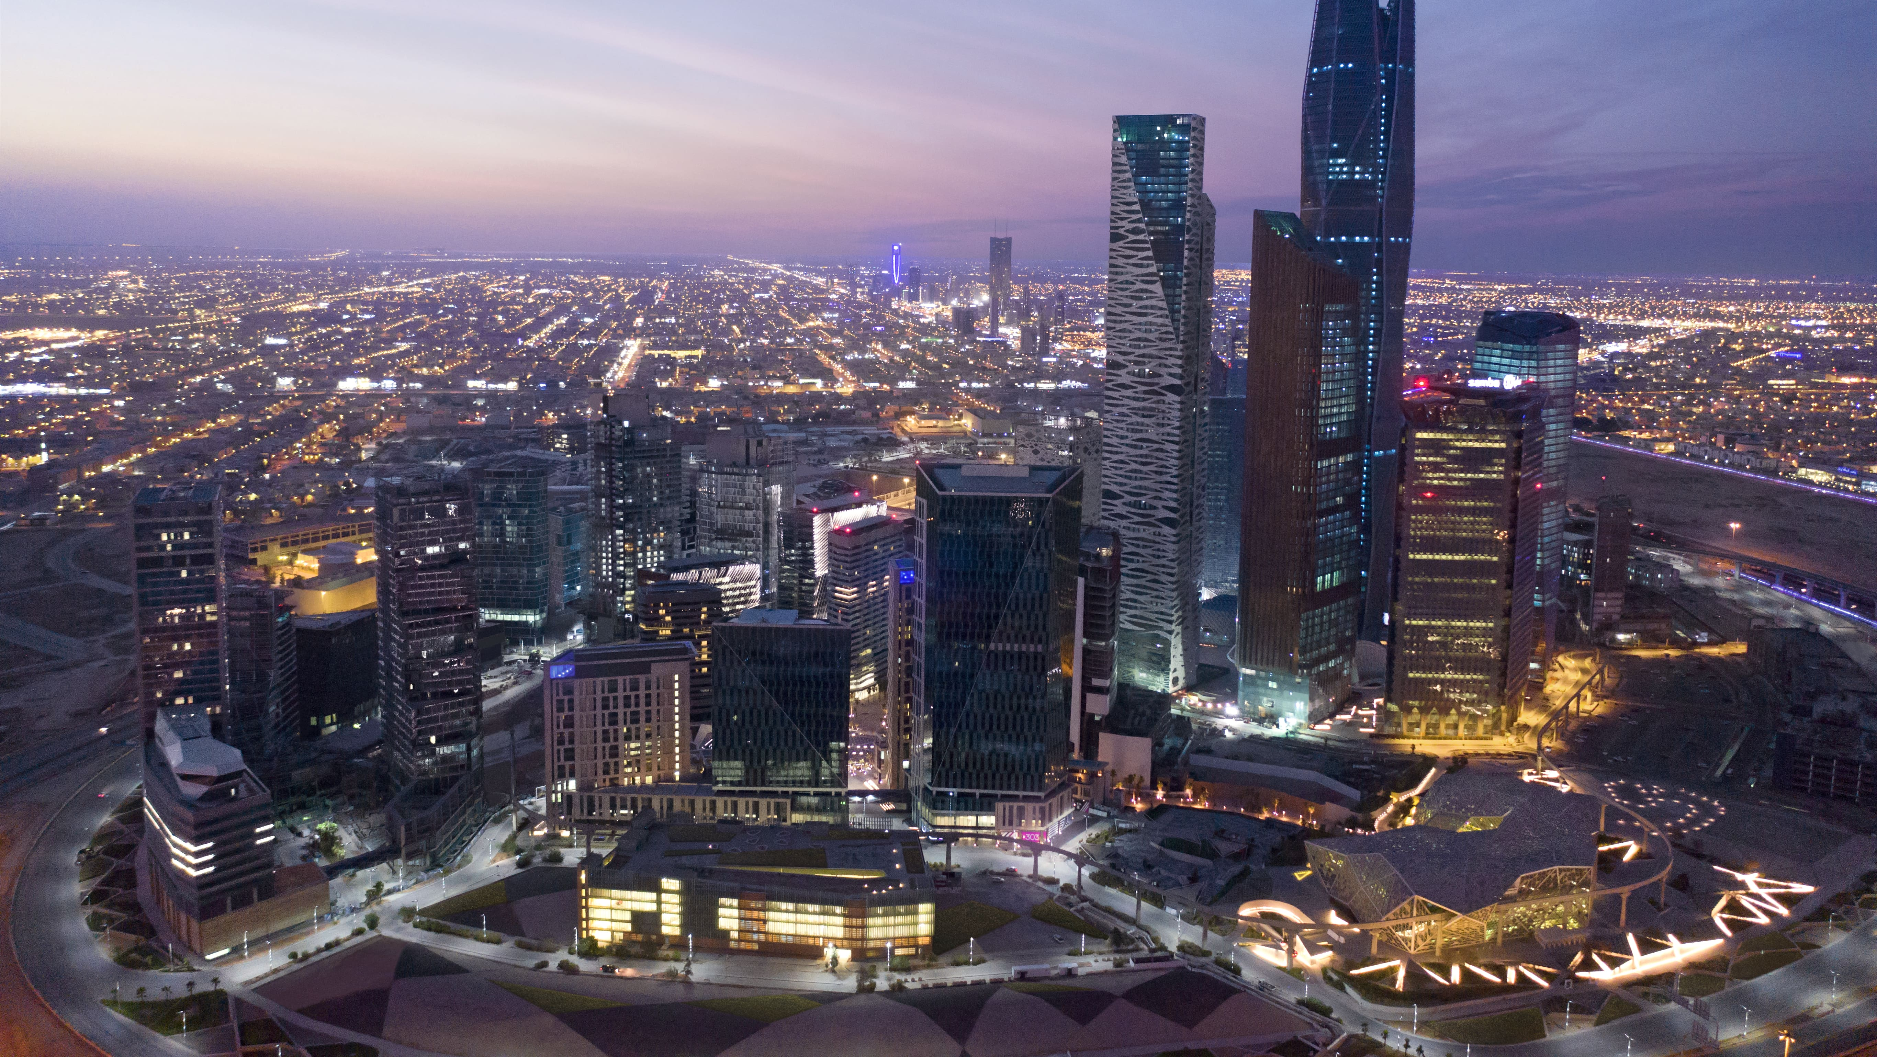

Slide 3
Executive Summary
The UrbanEye project explores the application of deep learning-based object detection for the automatic classification of urban street issues, specifically targeting 11 distinct categories such as graffiti, potholes, and broken signage. Leveraging the YOLOv11 architecture, known for its efficient performance and speed, the model processes urban scene images to identify and categorize visual irregularities. A dataset of 7,873 annotated images is utilized. Beyond standard training and inference, the project incorporates hyperparameter optimization through an evolutionary algorithm. This technique involves iterative training cycles, where model performance is evaluated, and optimal configurations are refined through genetic-inspired blending and mutation. The resulting robust and scalable model aims to enhance urban infrastructure monitoring and management, potentially aiding municipalities and smart city systems in improving public safety and Quality of Life.

Slide 5
Agenda
Quality of Life as one of Vision 2030 Programs
Urban Design Sector
Visual Pollution
Proposed Solution
Deep Learning and Computer Vision Image Detection Model
Dataset Preprocessing
Enhancement
Result
Future Recommendations

Slide 6
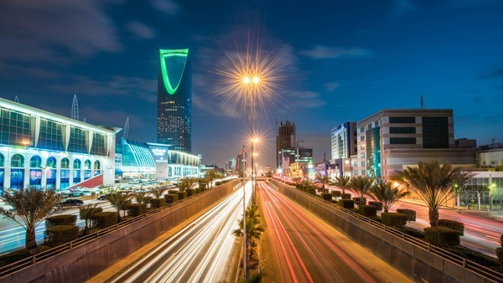

Slide 7

Quality of Life as one of Vision 2030 Programs
Conserve & promote the National, Arab, and Islamic heritage of the Kingdom
Increase public participation in sports and athletic activities
Launched in 2018, the Quality of Life Program is transforming Saudi Arabia into a world-renowned sports and entertainment location, a global tourism hotspot, and a top-ranked country people can call home.
Enhancing a wide variety of sectors, the Program focuses on the empowerment of arts and culture, promotion of sports and leading a healthy life, and the development of more livable urban areas. As well as creating exciting new sectors and diversifying economic activity, the Program is bolstering local employment opportunities and beautifying cities across the Kingdom. These efforts combine to create a better quality of life for all.
Continued innovation is delivering the promise of greater quality of life, underpinning Vision 2030’s ambitious goals for a more livable and vibrant society
Reach regional & global excellence in selected professional sport
Improve the quality of services provided in Saudi cities
Improve the urban landscape in Saudi cities
Enhance the nation’s immunity towards drug abuse
Develop & diversify entertainment opportunities to meet the population’s needs
Grow Saudi contribution to arts & culture
Enable the development of the tourism sector
Improve living conditions for expats

Slide 8
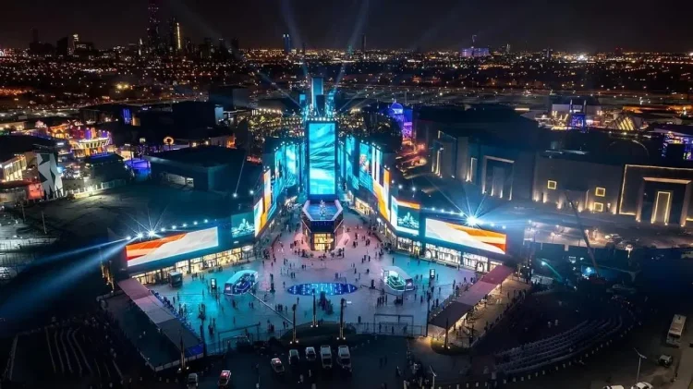

Slide 9
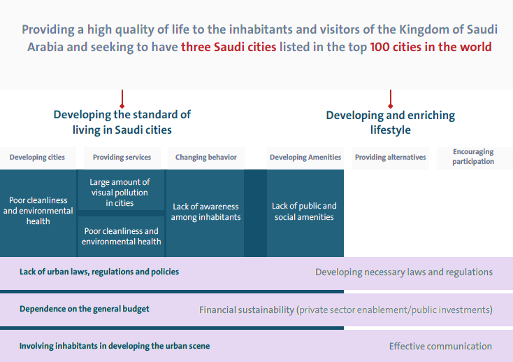
Urban Design Sector
Improve the urban landscape in Saudi cities: the improvement of the urban landscape of public places for people to enjoy (for example, green landscapes and public parks) requires enforcement and adherence to a comprehensive urban code to ensure the aesthetic value, and to eliminate visual pollution (garbage piles, construction sites, etc.)
Sector Gap Analysis with the Program’s Strategy
Visual pollution
Visual pollution is the degradation of the visual environment due to unattractive or disruptive elements that negatively impact the aesthetic quality of an area. It can affect urban, suburban, and natural landscapes.

Slide 10
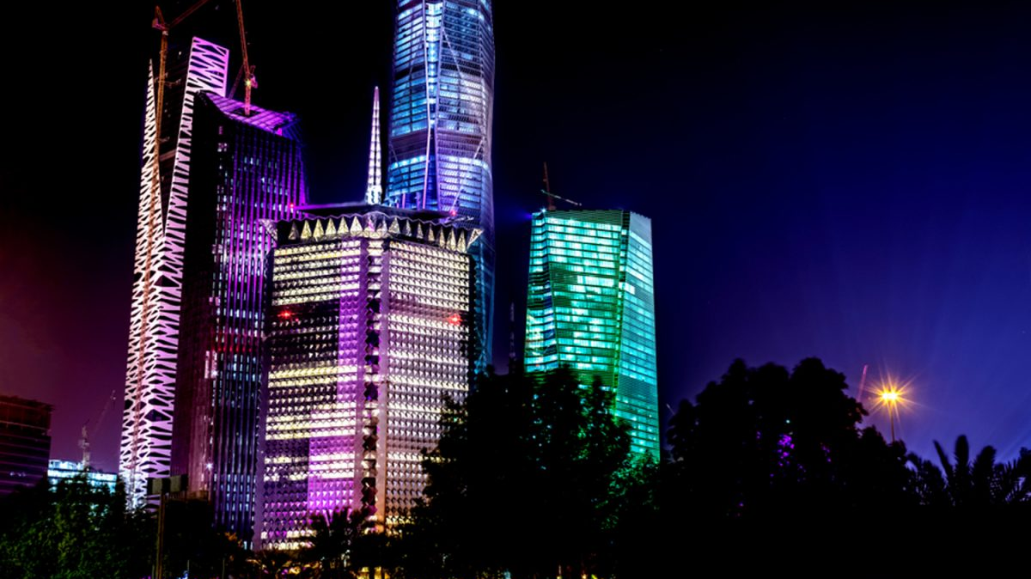

Slide 11



developing a deep learning Model to automatically identify Visual Pollution
Problem
Current Treatment
Proposed Solution
Saudi cities today are struggling with increasing levels of visual pollution issues like graffiti, broken or faded signage, potholes, and poorly maintained infrastructure all of which negatively impact the urban experience
Traditional monitoring methods rely heavily on manual inspections or citizen reporting, which are often time-consuming, inconsistent, and difficult to scale.
Developing and evaluating a deep learning-based object detection system using YOLOv11 to automatically identify and classify 11 types of urban street issues, such as graffiti, potholes, damaged signage, litter, and neglected facades

Slide 12
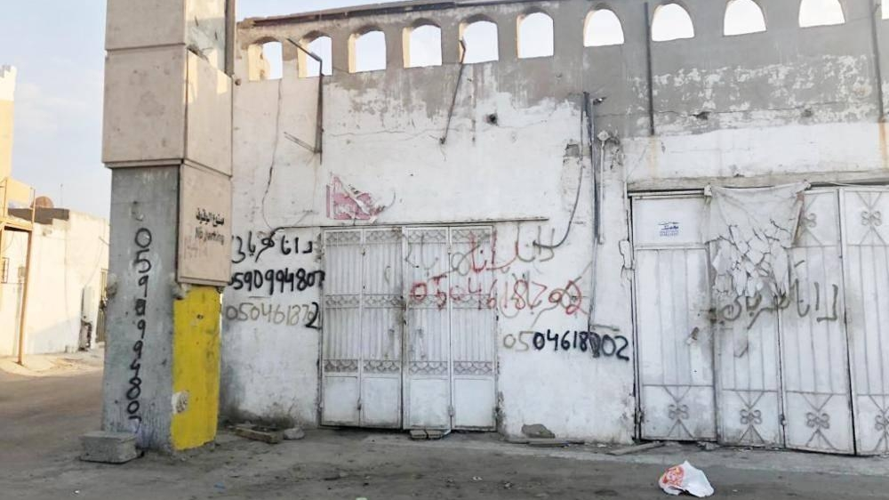

Slide 13
Proposed Solution
Dataset Preparation
Model Training & Optimization
Model Testing & Evaluation
Comparative Analysis
Develop a YOLOv11-based deep learning model for real-time detection and classification of 11 urban street anomalies that involves:
Identify and classify 11 types of urban street issues on a dataset of 7,873 images, comprising 5,511 training images, 1,181 evaluation images, and 1,181 test images
Training and fine-tuning the model, evaluating its performance using metrics like mean Average Precision (mAP)
Assessing the model’s adaptability by testing it on unseen urban datasets with different city layouts, weather conditions, and camera angles.
Benchmarking the model with different models, baseline, regularized, adding synthetic data, and weighted images

Slide 14
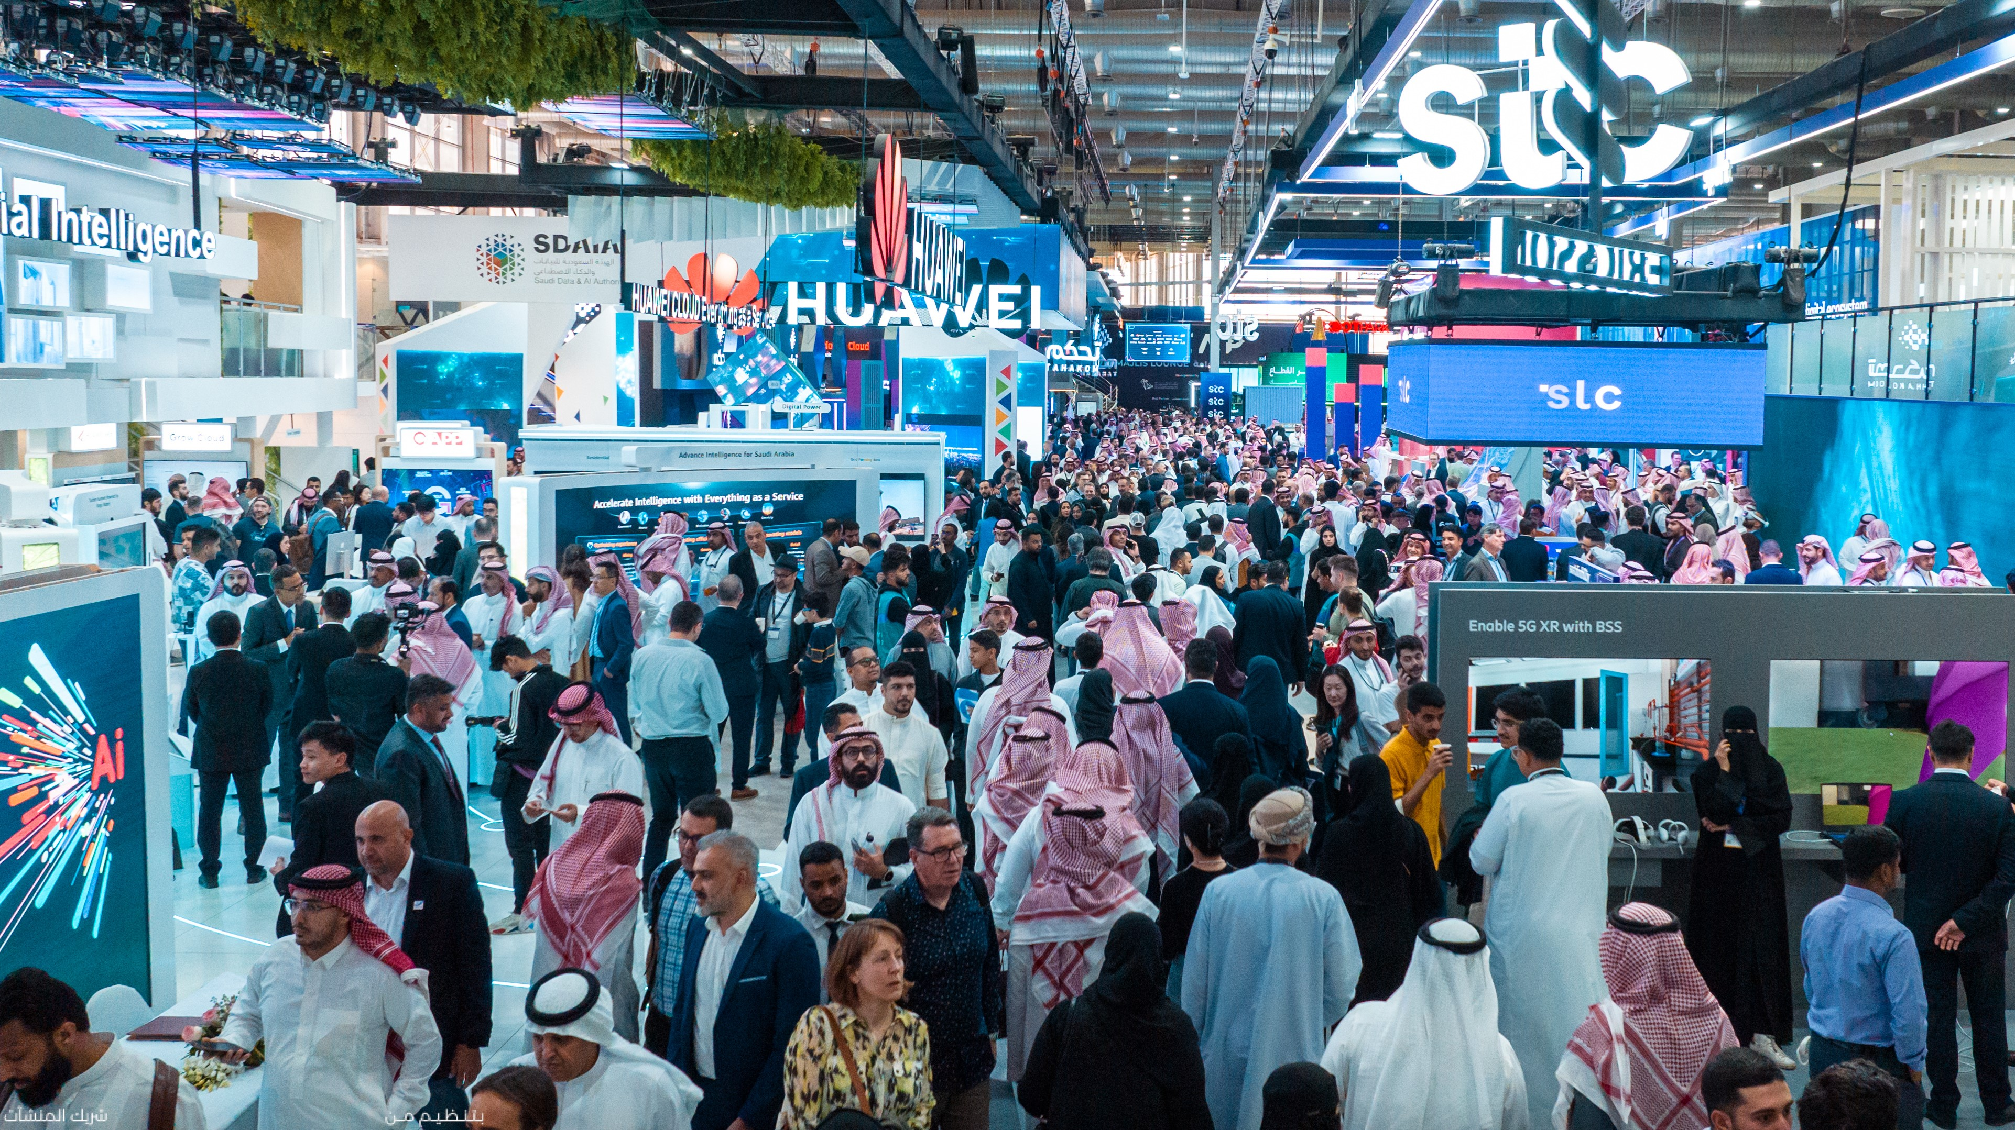

Slide 15

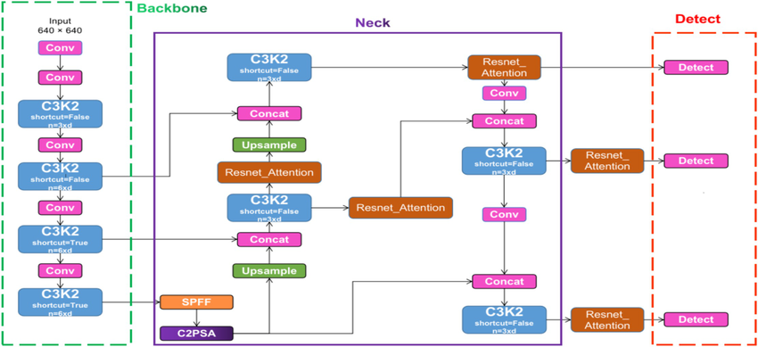
Yolo You Only Look Once

Slide 16
Yolo You Only Look Once
Backbone
Transition Layer
Neck
Head
Feature Extraction
Multi-Scale Pooling (SPPF)
Feature Refinement
Prediction and Output
C2PSA allowing the model to focus more effectively on critical and more informative regions. This is particularly valuable when detecting partially hidden or small objects
C3K2 is a specialized convolutional block designed to enhance feature extraction while maintaining computational efficiency
C3K2
SPPF Aggregates multi-scale features by pooling different spatial regions, improving the model's ability to detect objects of varying sizes without significantly slowing down inference.
CBS (Convolution-BatchNorm-SiLU) layers to efficiently process feature maps, generating precise bounding box coordinates and classification probabilities.
C3K2

Slide 17






Preprocessing
To enable effective model training, essential preprocessing steps were applied to enhance data quality, including image resizing, annotation standardization, class balancing, and format optimization for YOLOv11 compatibility
Total Images
7,873 (Training: 5,511; Validation: 1,181; Testing: 1,181)
Initially 11 distinct classes, one class was excluded due to insufficient data (only one sample provided)
Categories
Dataset images originally had a resolution of 1920x1080 pixels. These images were resized to 640x640
Image Resolution
Labels were provided in diverse formats, necessitating conversion to the YOLO-compatible format
Label Conversion
Crop-based Synthetic Image Generation
Avoid unintentionally increasing instances of majority classes, as dataset has minority image classes

Slide 18
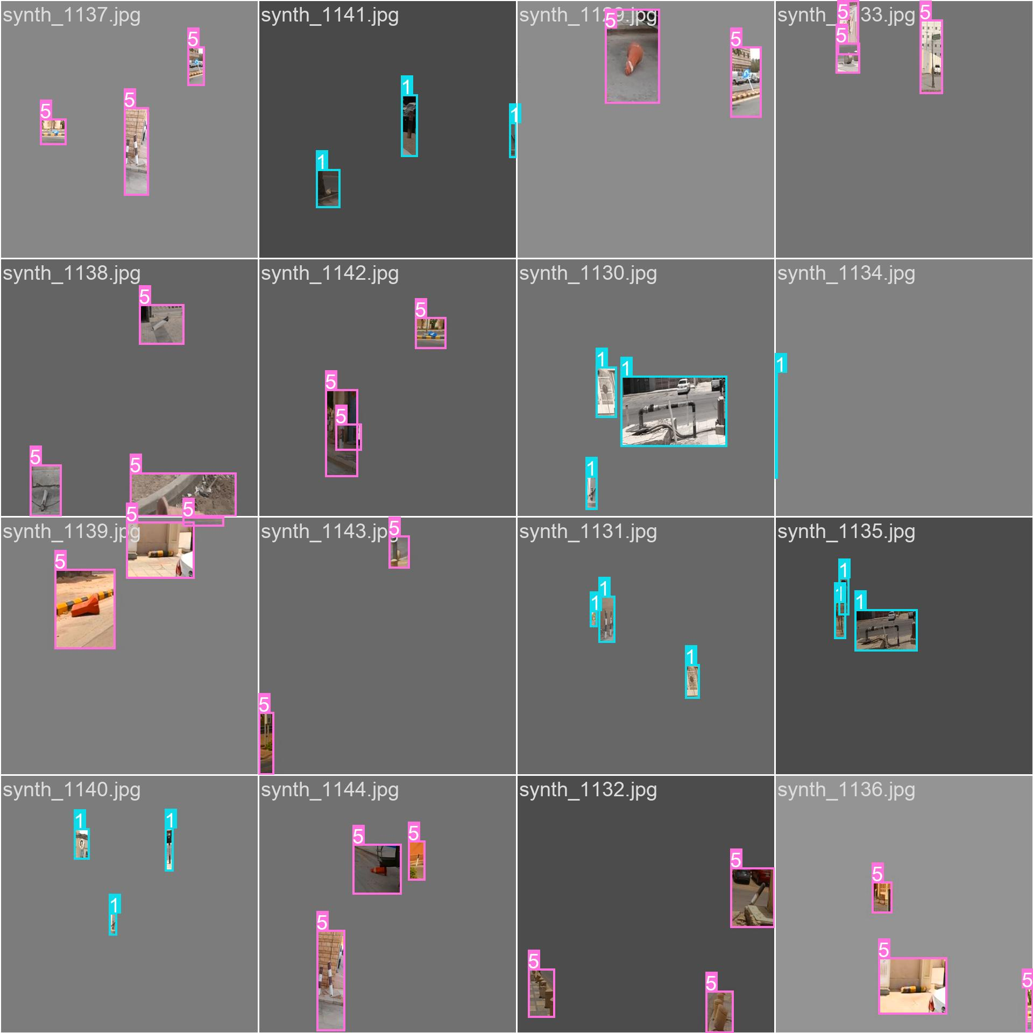
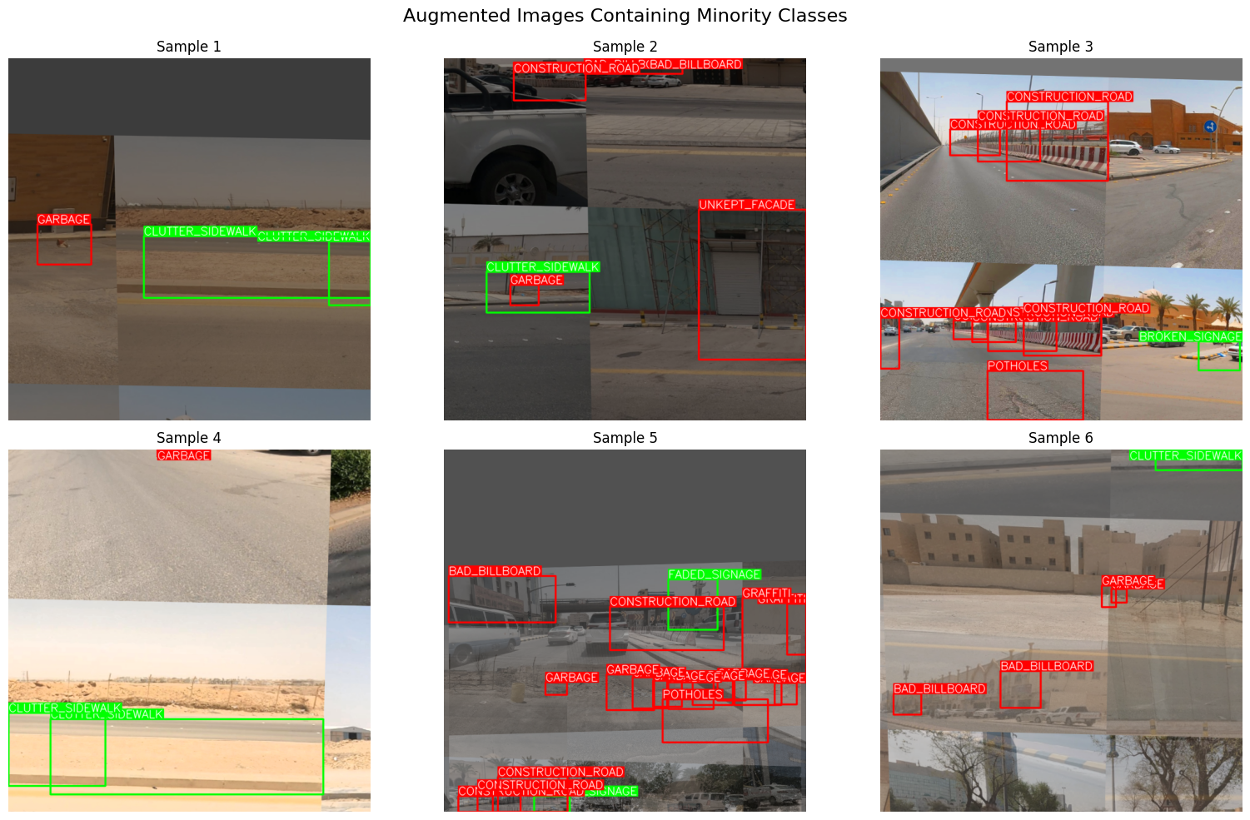
Preprocessing
Sample Augmented Images
Sample Synthetic Images

Slide 19
Enhancement
1
2
3
4
5
Baseline (Vanilla)
Baseline (Vanilla)
Baseline (Vanilla)
Baseline (Vanilla)
Baseline (Vanilla)
Synthetic images
Enhanced Augmentation
Synthetic images
Synthetic images
Enhanced Augmentation
Enhanced Augmentation
Weighted Loss

Slide 20
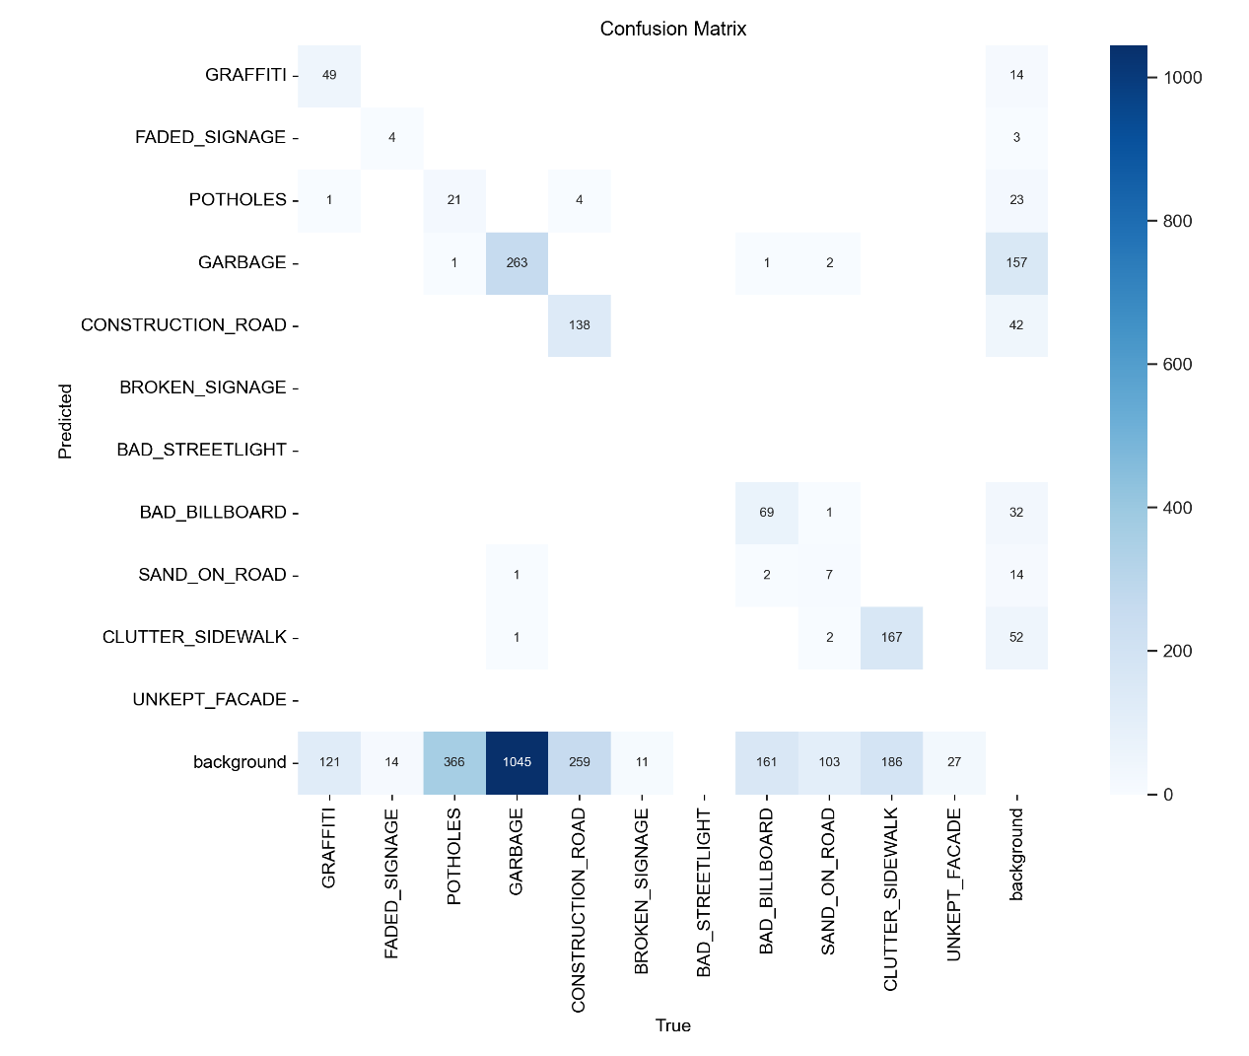
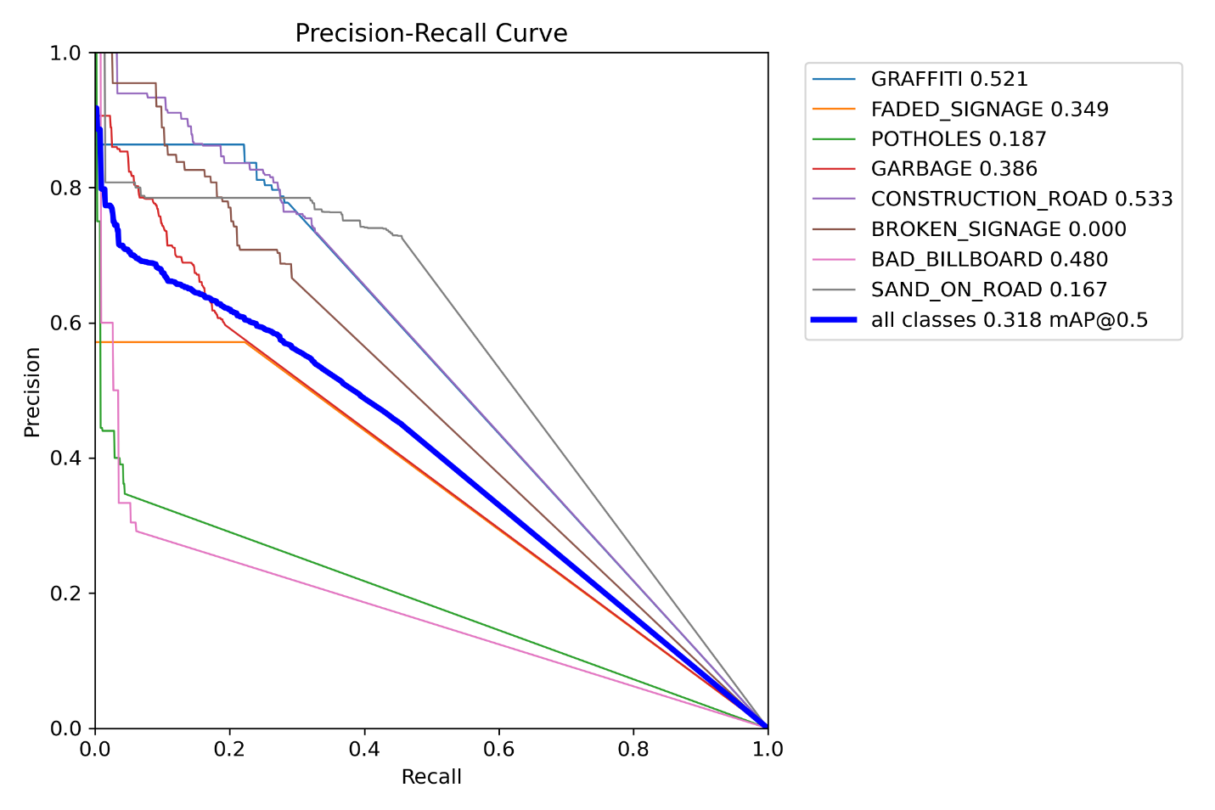
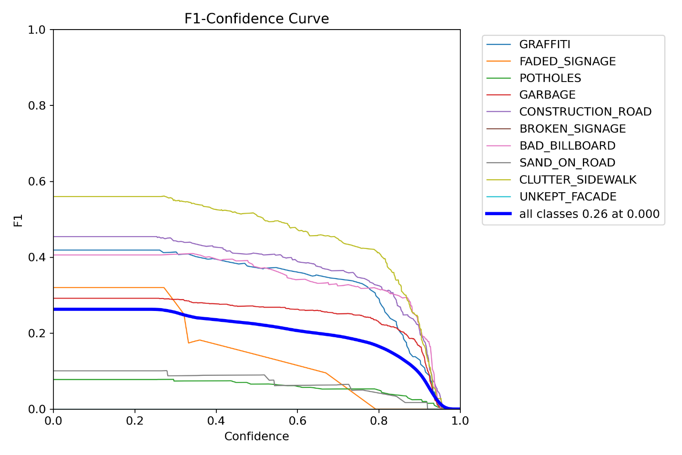
Enhancement
2
3
Performance Metrics
1
4
5
Baseline (Vanilla)
mAP50 | mAP50–95 | Precision | Recall
0.318 | 0.160 | 0.471 | 0.188

Slide 21
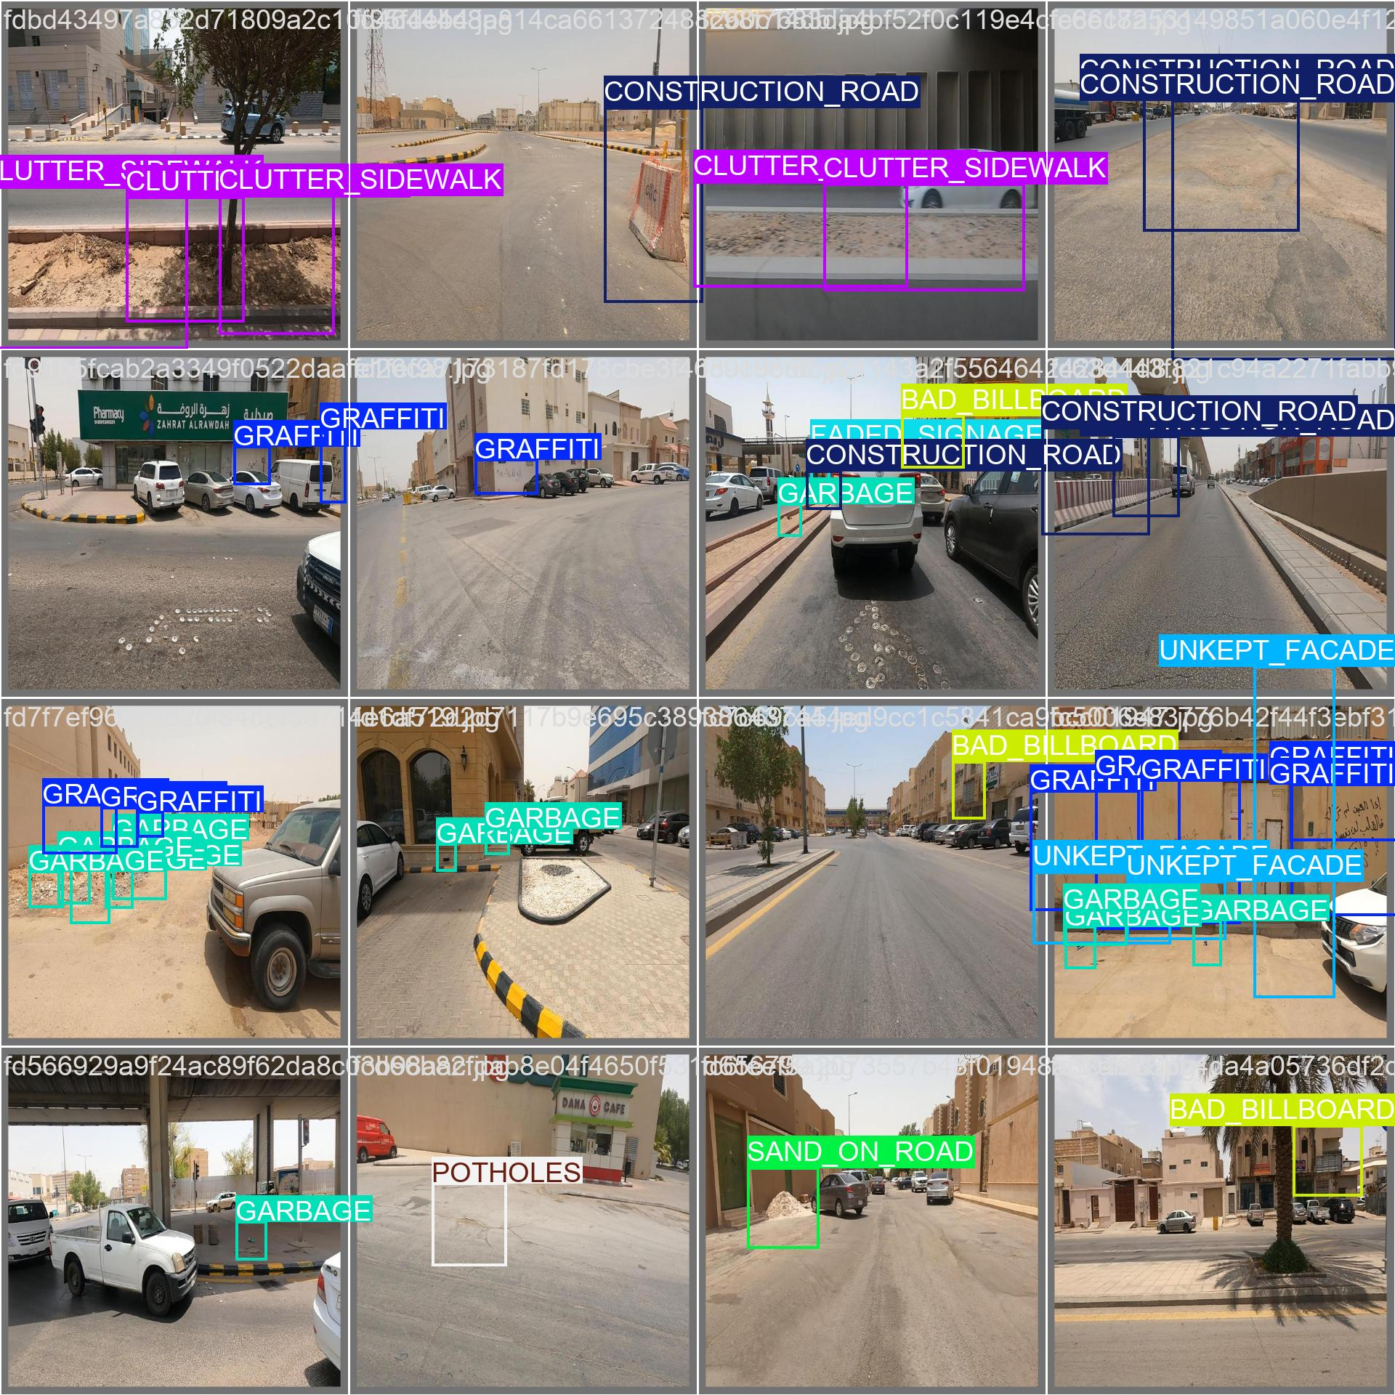
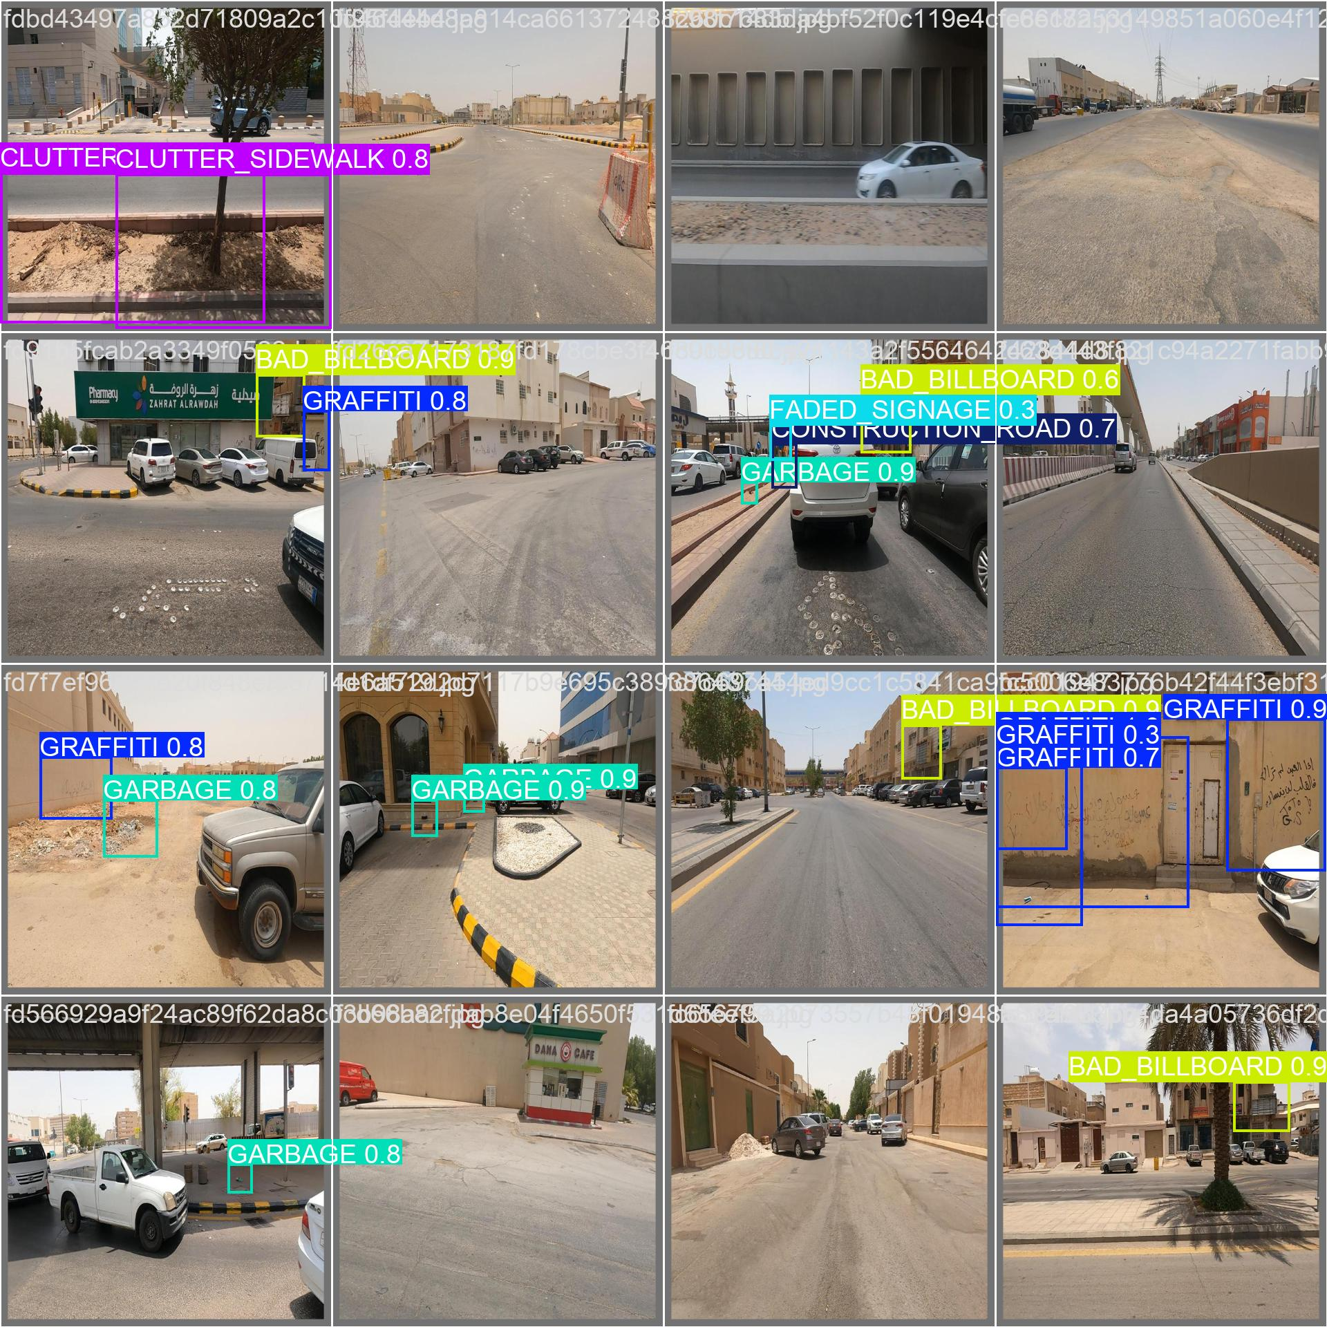

Enhancement
2
3
Performance Metrics
1
4
5
Baseline (Vanilla)
mAP50 | mAP50–95 | Precision | Recall
0.318 | 0.160 | 0.471 | 0.188
Actual
Predicted

Slide 22

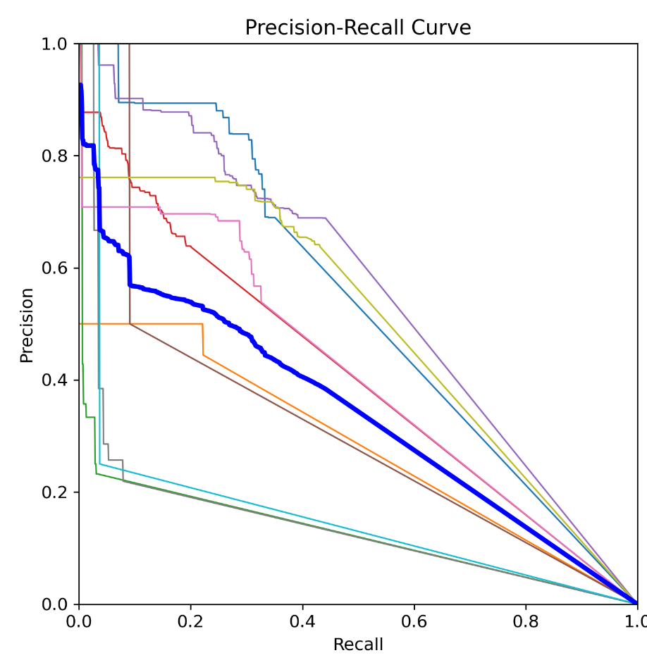
Enhancement
1
2
3
4
5
Performance Metrics
mAP50 | mAP50–95 | Precision | Recall
0.344 | 0.164 | 0.484 | 0.221
Baseline (Vanilla)
Synthetic images

Slide 23
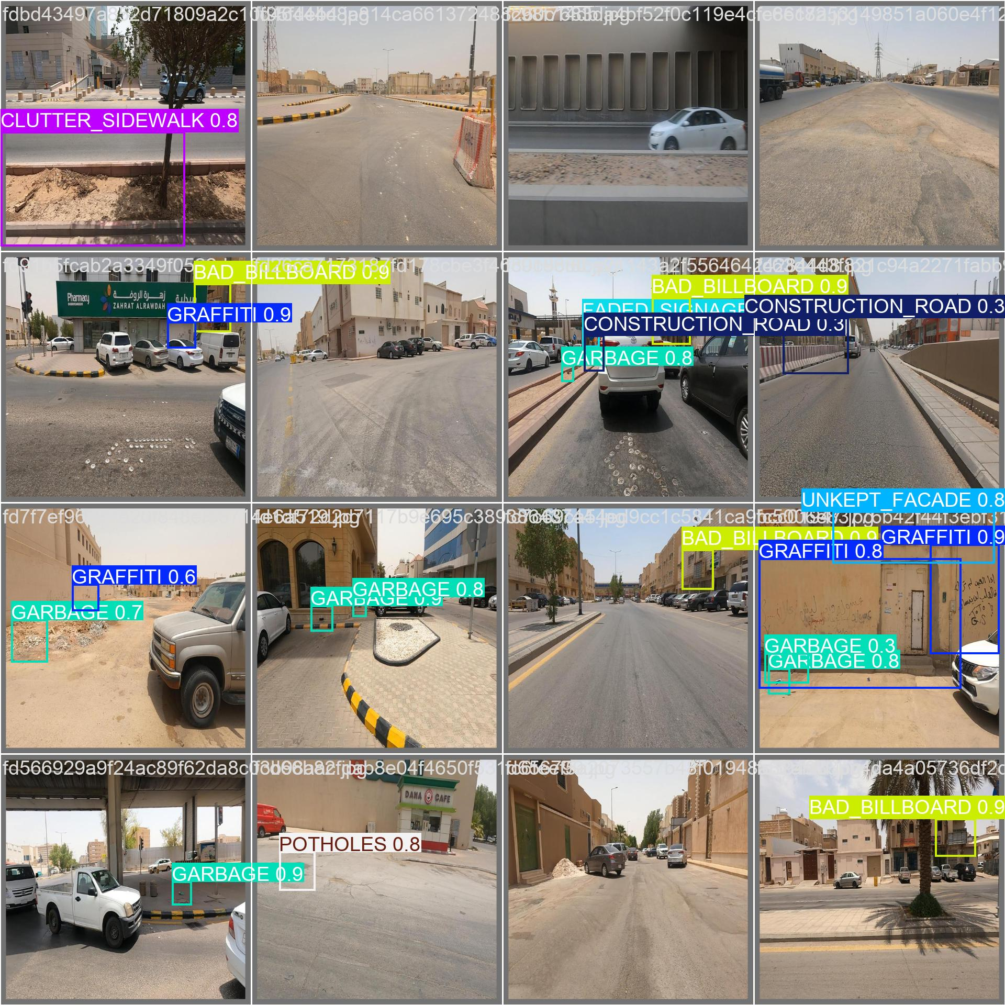
Enhancement
1
2
3
4
5
Performance Metrics
mAP50 | mAP50–95 | Precision | Recall
0.344 | 0.164 | 0.484 | 0.221
Baseline (Vanilla)
Synthetic images
Predicted
Actual

Slide 24
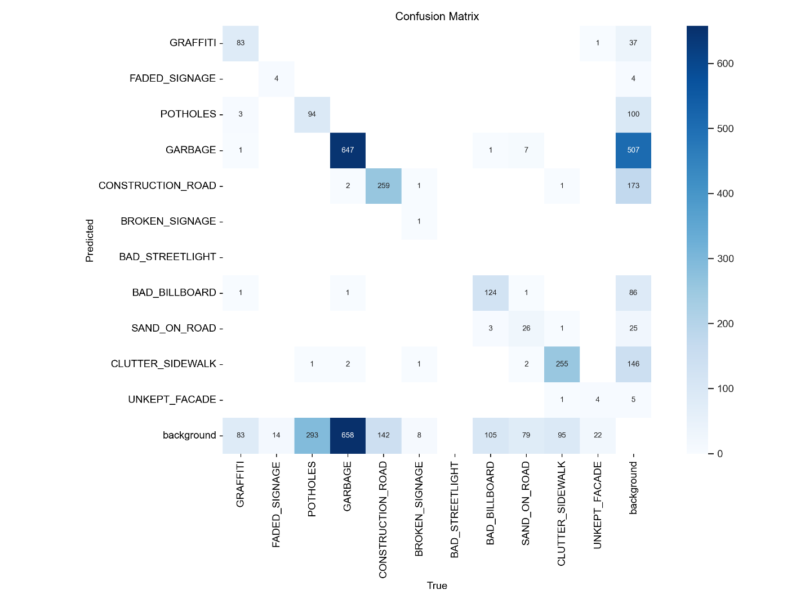
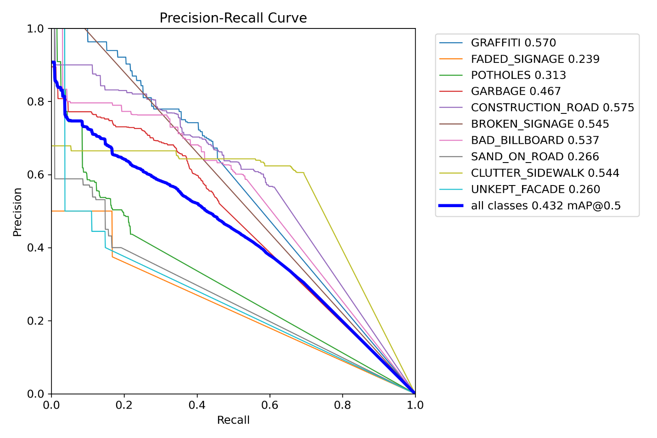
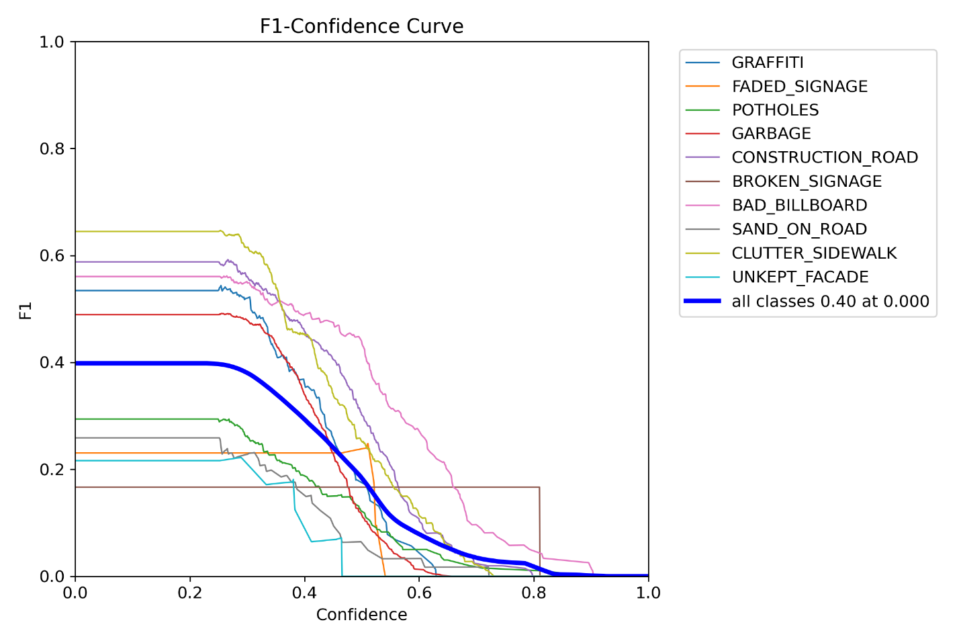
Enhancement
1
2
3
4
5
Baseline (Vanilla)
Enhanced Augmentation
Performance Metrics
Model | mAP50 | mAP50–95 | Precision | Recall
Baseline + Enh. Aug. | 0.432 | 0.240 | 0.553 | 0.358

Slide 25
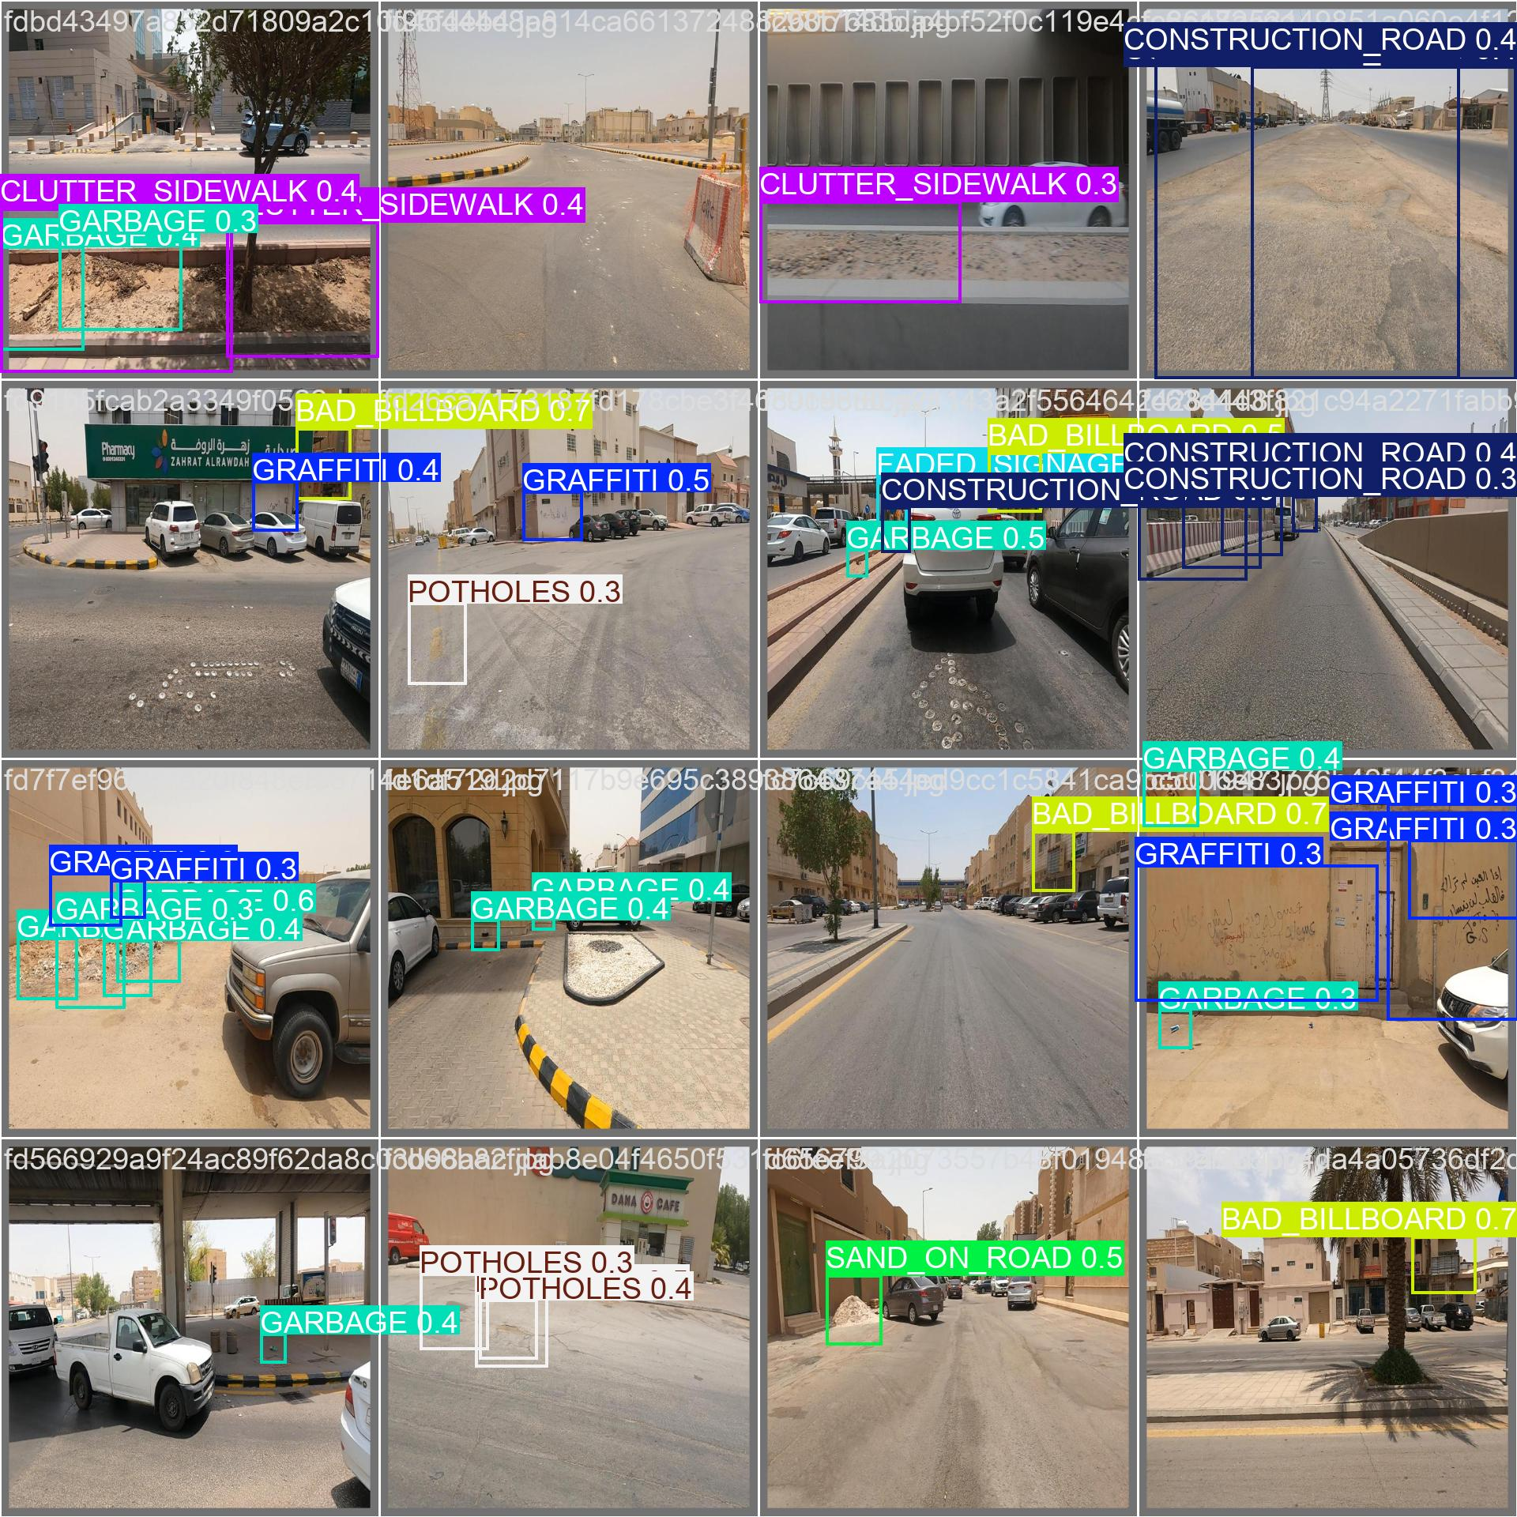
Enhancement
1
2
3
4
5
Baseline (Vanilla)
Enhanced Augmentation
Performance Metrics
Model | mAP50 | mAP50–95 | Precision | Recall
Baseline + Enh. Aug. | 0.432 | 0.240 | 0.553 | 0.358
Actual
Predicted

Slide 26
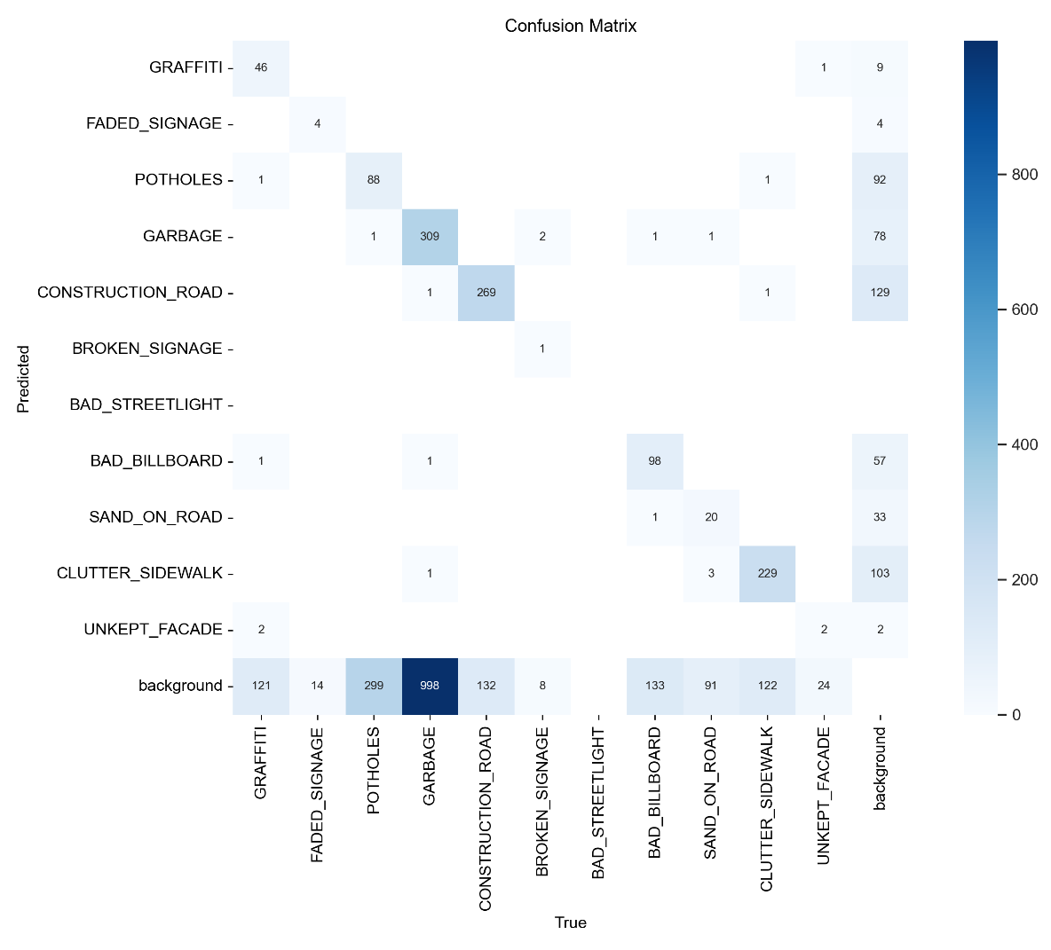
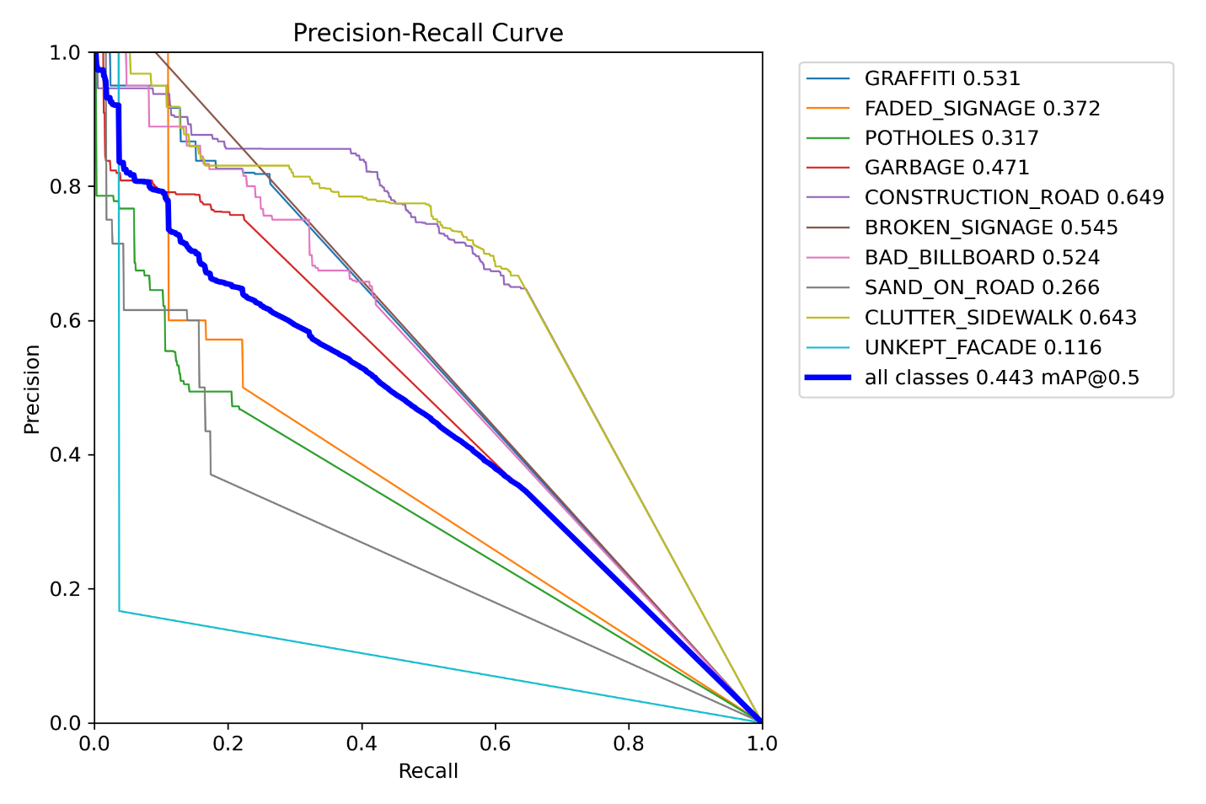
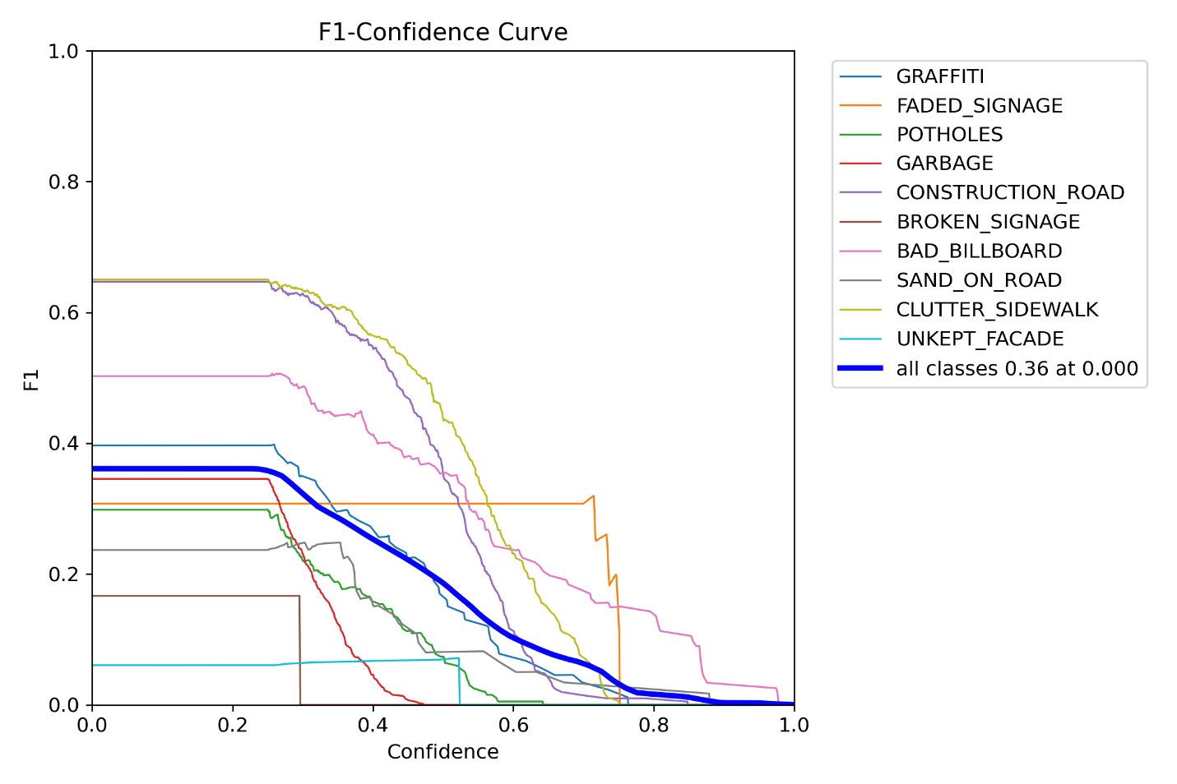
Enhancement
Baseline (Vanilla)
Synthetic images
Enhanced Augmentation
1
2
3
4
5
Performance Metrics
mAP50 | mAP50–95 | Precision | Recall
0.443 | 0.211 | 0.400 | 0.293

Slide 27
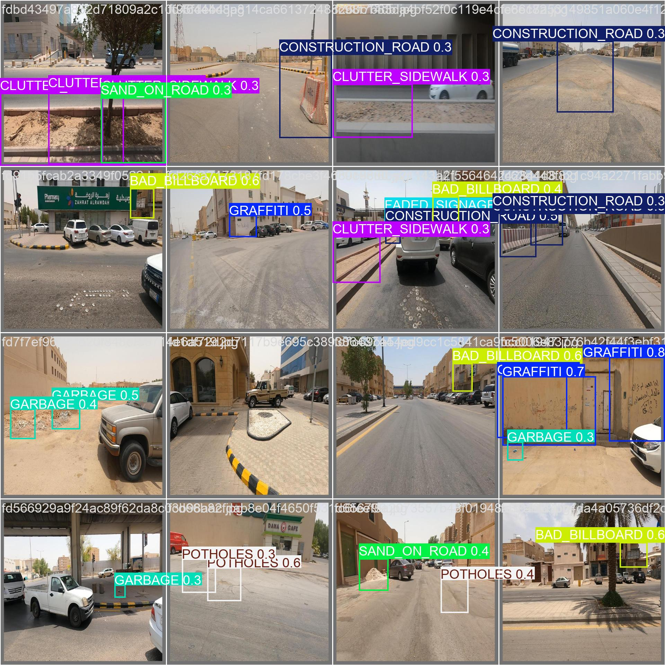
Enhancement
Baseline (Vanilla)
Synthetic images
Enhanced Augmentation
1
2
3
4
5
Performance Metrics
mAP50 | mAP50–95 | Precision | Recall
0.443 | 0.211 | 0.400 | 0.293
Predicted
Actual

Slide 28
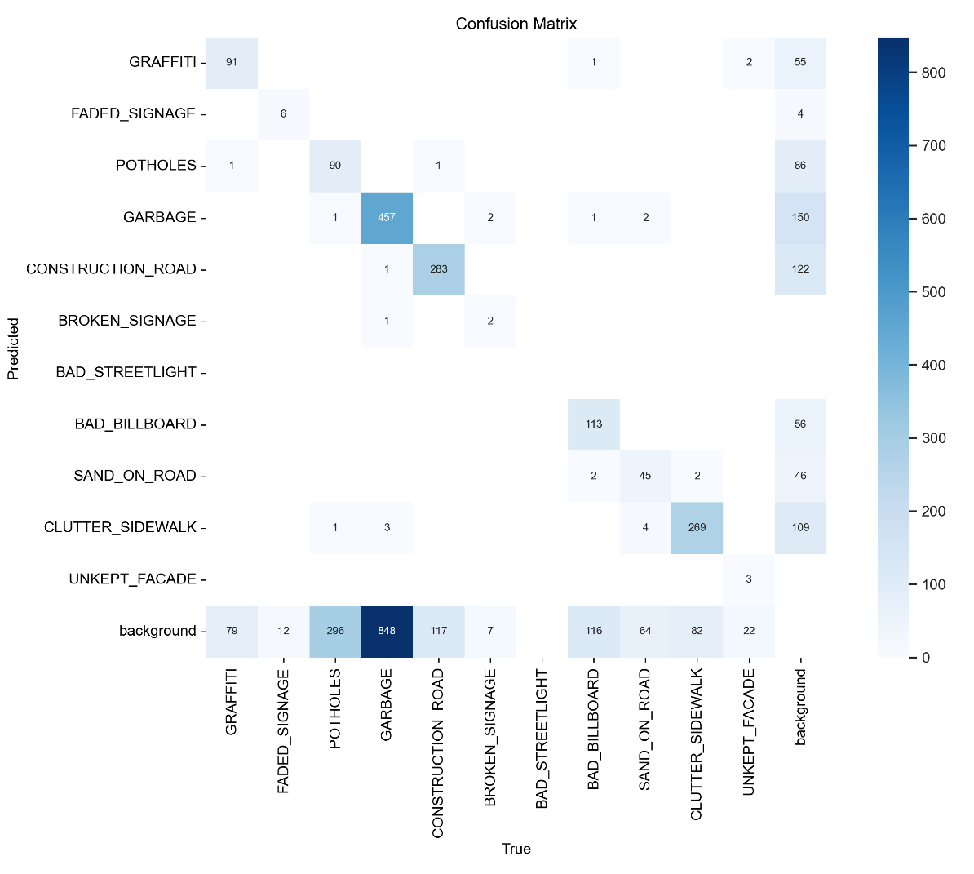
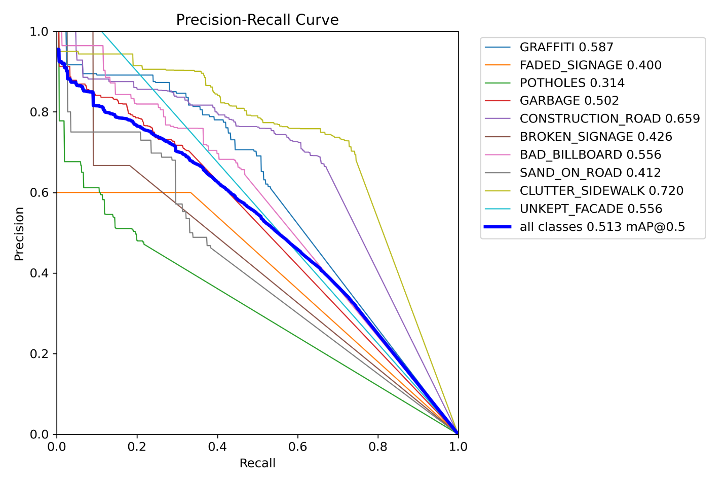
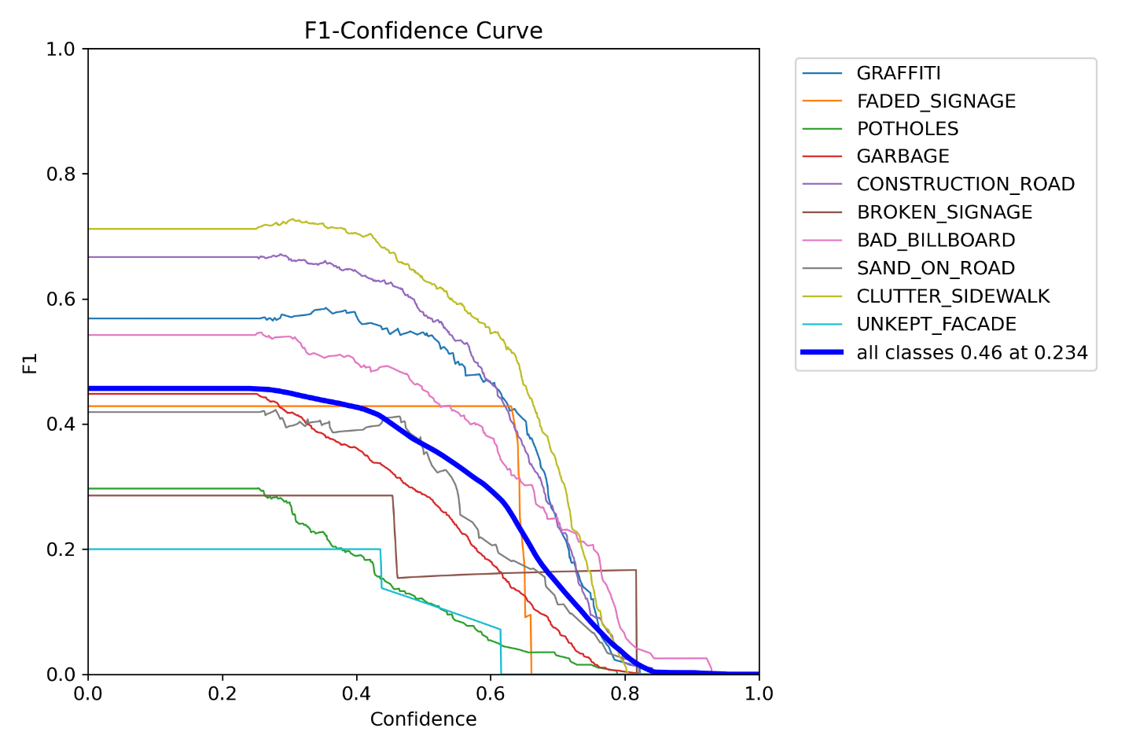
Enhancement
Baseline (Vanilla)
Synthetic images
Enhanced Augmentation
Weighted Loss
1
2
3
4
5
Performance Metrics
mAP50 | mAP50–95 | Precision | Recall
0.513 | 0.260 | 0.650 | 0.397

Slide 29
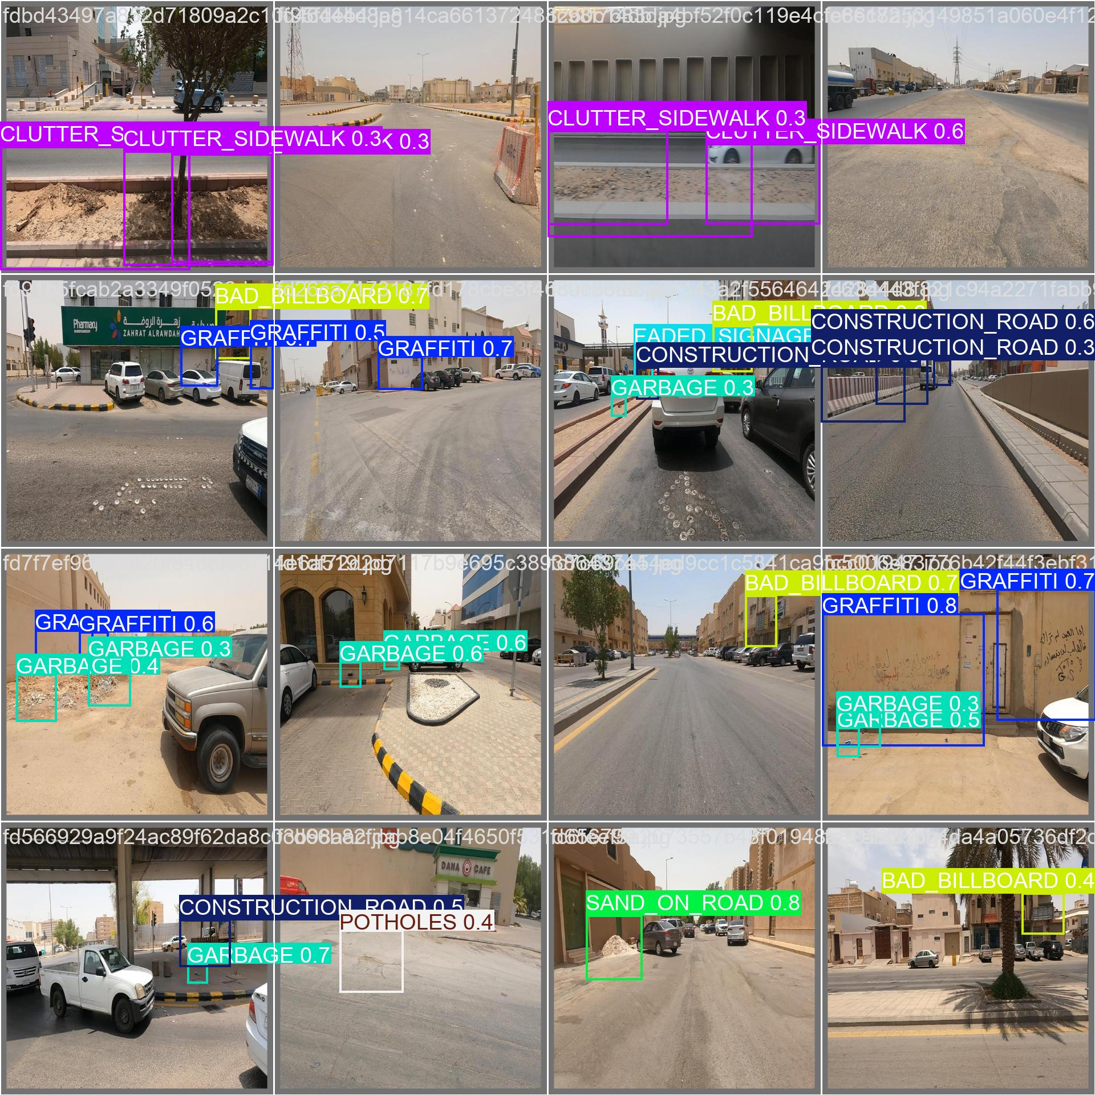
Enhancement
Baseline (Vanilla)
Synthetic images
Enhanced Augmentation
Weighted Loss
1
2
3
4
5
Performance Metrics
Predicted
mAP50 | mAP50–95 | Precision | Recall
0.513 | 0.260 | 0.650 | 0.397
Actual

Slide 30
Result
Clear progression in performance as incremental improvements are applied to the baseline model. Incorporating synthetic data balancing led to moderate gains across all metrics compared to the YOLOv11 Baseline. Introducing enhanced data augmentation further improved detection accuracy and generalization. Combining both synthetic images and augmentation resulted in additional performance boosts. Finally, applying a class-weighted loss function achieved the highest scores across all evaluation metrics, highlighting the cumulative benefits of addressing class imbalance through both data-level and loss-level strategies
Model | mAP50 | mAP50–95 | Precision | Recall
 | 0.318 | 0.160 | 0.471 | 0.188
 | 0.344 | 0.164 | 0.484 | 0.221
 | 0.432 | 0.240 | 0.553 | 0.358
 | 0.443 | 0.211 | 0.600 | 0.293
 | 0.513 | 0.260 | 0.650 | 0.397
1
2
3
4
5

Slide 31
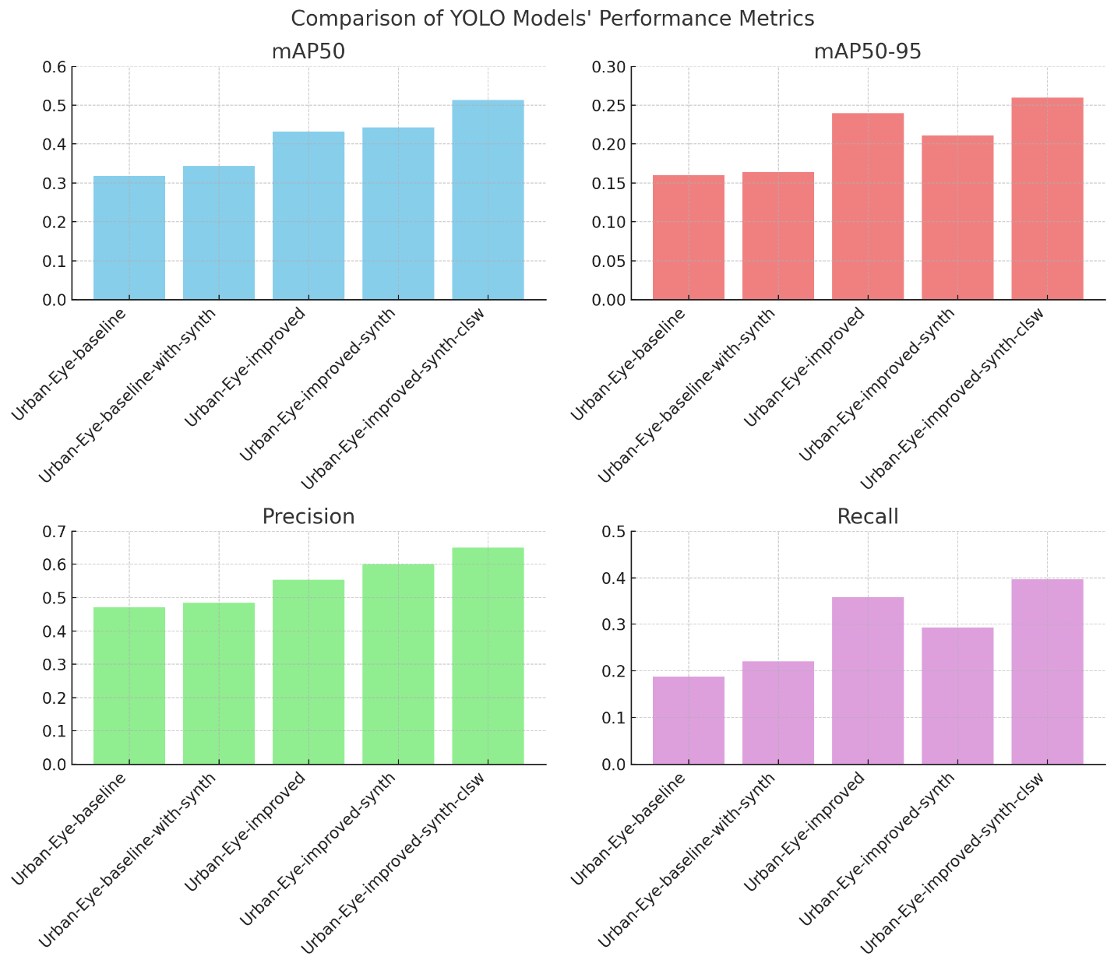
Result

Slide 32
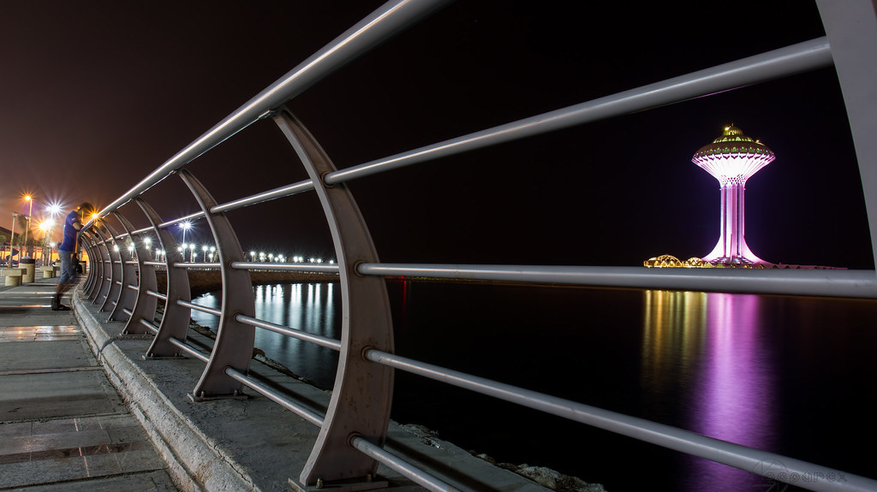

Slide 33

Future Recommendation
Based on the activities conducted, research analysis, and technical evaluations, the project team has identified several key challenges and proposed recommendations to enhance the project's success
Limited Training Data: The available dataset is small and lacks diversity, limiting model generalization.
Geographical Restriction: All collected data is currently sourced only from Riyadh, which reduces the model’s applicability to other urban settings.
Daytime-Only Captures: All images were collected during daylight hours, missing night-time and low-light variations crucial for real-world urban monitoring.
Incomplete Category Coverage: The existing dataset does not adequately represent all visual pollution classes targeted by the project.
Dependence on Single Reference Source: Data collection and labeling rely heavily on one reference system, increasing the risk of dataset bias.
Autonomous Data Collection: Deploy autonomous vehicles equipped with cameras to systematically capture images across varied environments, times, and weather conditions.
Expand to All Cities: Broaden the data collection campaign to include diverse regions and cities for greater geographic variability and model robustness.
Citizen Integration: Integrate existing citizen applications to crowdsource images, along with geolocation metadata, to enhance dataset size and diversity.
Stakeholder Collaboration: Engage with urban management stakeholders to ensure faster issue identification, resolution feedback, and iterative model improvement.

Slide 34
make it easier for cities to keep track of what's going on, and hopefully, make things a bit nicer for everyone.

